Slide 1
Lecture 8: Stream Cipher and RC4
An Introduction to Information Security
School of Big Data and Software Engineering, CQU
Fall, 2018

Slide 2
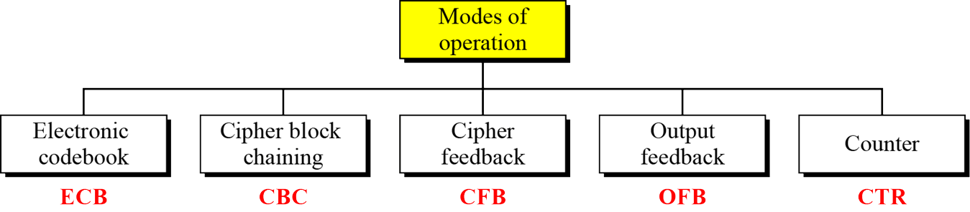
Quickly Review
2
Lecture 7
More Advance Symmetric-key Ciphers
IDEA
Blowfish
RC5
Block Cipher Modes of Operation
2018/10/9
An Introduction to Information Security

Slide 3

Outline
1. Stream Cipher
2. RC4

Slide 4
Lecture 8: Stream Cipher and RC4
4
1. Stream Cipher
2…
Stream Cipher: Overview
process message bit by bit (as a stream)
produce a pseudo-random(伪随机) keystream
combined(结合) (XOR) with plaintext bit by bit
randomness of stream key completely destroys statistically(统计的) properties in message
Ci = Pi XOR StreamKi
but must never reuse stream key
otherwise can recover messages
2018/10/9
An Introduction to Information Security

Slide 5
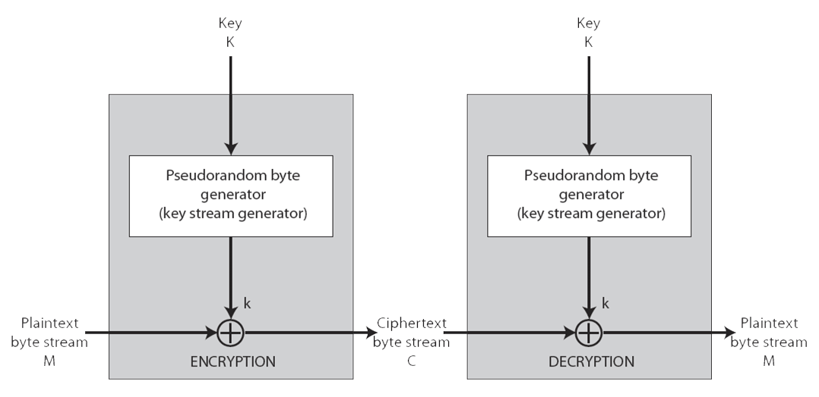
Lecture 8: Stream Cipher and RC4
5
1. Stream Cipher
2…
Stream Cipher: Structure
11001100
plaintext
+
01101100
key stream
10100000
ciphertext
2018/10/9
An Introduction to Information Security

Slide 6
Lecture 8: Stream Cipher and RC4
6
1. Stream Cipher
2…
Stream Cipher: Properties
some design considerations(需要考虑的方面) are:
long period with no repetitions(重复)
statistically random
depends on large enough key
large linear complexity(复杂性)
properly designed, can be as secure as a block cipher with same size key
but usually simpler & faster
…
Cipher | Key size | Speed (Mbps)
DES | 56 | 9
3DES | 168 | 3
RC2 | variable | 0.9
RC4 | variable | 45
2018/10/9
An Introduction to Information Security

Slide 7
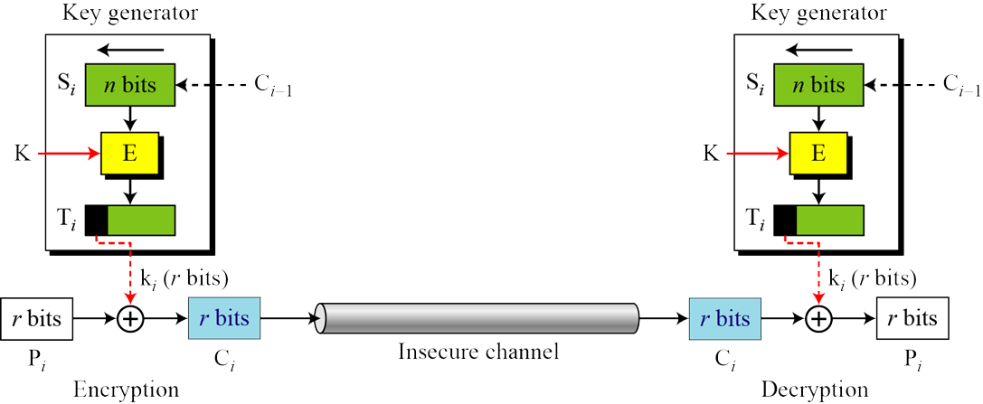
Lecture 8: Stream Cipher and RC4
7
1. Stream Cipher
2…
Stream Cipher: with Block Cipher modes
Cipher FeedBack (CFB)
2018/10/9
An Introduction to Information Security

Slide 8
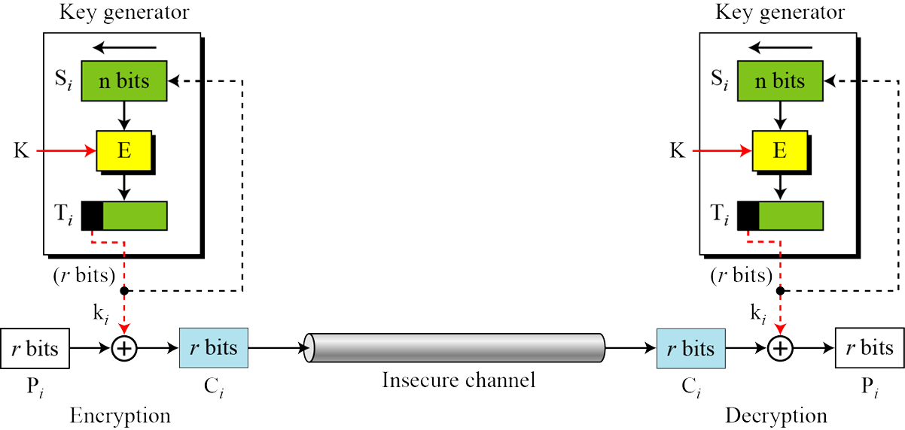
Lecture 8: Stream Cipher and RC4
8
1. Stream Cipher
2…
Stream Cipher: with Block Cipher modes
Output FeedBack (OFB)
2018/10/9
An Introduction to Information Security

Slide 9
Outline
1. Stream Cipher
2. RC4

Slide 10

Lecture 8: Stream Cipher and RC4
10
1…
2. RC4
RC4: Overview
RC4 is a byte-oriented stream cipher in which a byte of a plaintext is X-ored with a byte of key to produce a byte of a ciphertext.
a proprietary(私有的) cipher owned by RSA DSI
another Ron Rivest design in 1987, simple but effective
variable key size, byte-oriented stream cipher
widely used (web SSL/TLS, wireless WEP)
key forms random permutation of all 8-bit values
uses that permutation to scramble(搅乱) input information processed a byte at a time
2018/10/9
An Introduction to Information Security

Slide 11

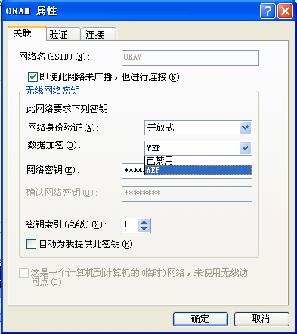
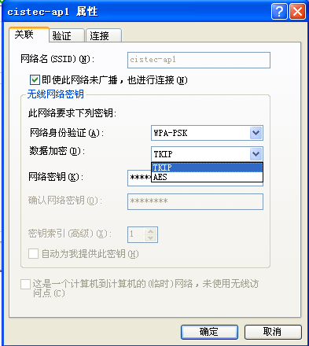
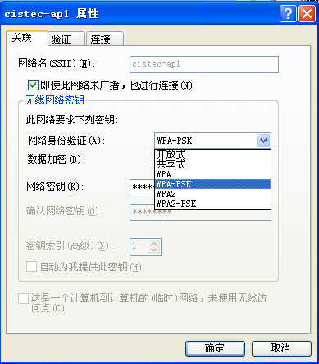
Lecture 8: Stream Cipher and RC4

Slide 12
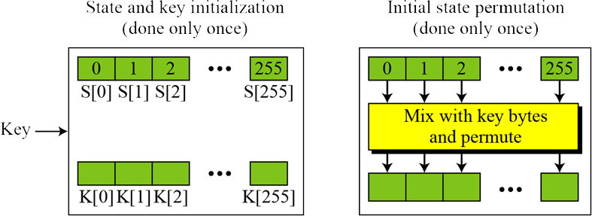
Lecture 8: Stream Cipher and RC4
12
1…
2. RC4
RC4 : Structure
2018/10/9
An Introduction to Information Security

Slide 13
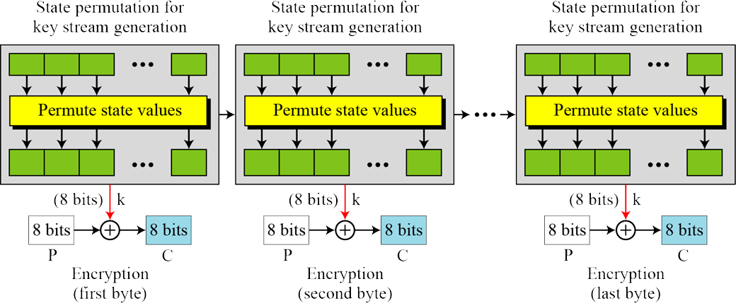
Lecture 8: Stream Cipher and RC4
13
1…
2. RC4
RC4 : Structure
2018/10/9
An Introduction to Information Security

Slide 14
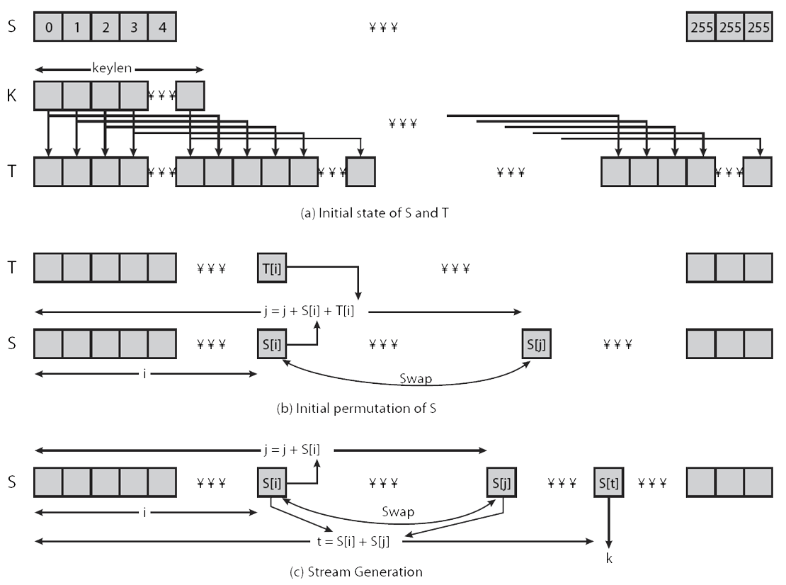
Lecture 8: Stream Cipher and RC4
14
1…
2. RC4
Stream Cipher: Procedure
2018/10/9
An Introduction to Information Security

Slide 15
Lecture 8: Stream Cipher and RC4
S
00000000
00000001
00000010
00000011
00000100
00000101
……..
11111111
11111111
S₀=0
S₁=1
S₂=2
S₃=3
S₄=4
S₅=5
...
S₂₅₅=255
S₂₅₅
K
xxxxxxxx
xxxxxxxx
xxxxxxxx
k₁
…
k_{n}
T
xxxxxxxx
xxxxxxxx
xxxxxxxx
xxxxxxxx
xxxxxxxx
xxxxxxxx
...
xxxxxxxx
xxxxxxxx
xxxxxxxx
k₁
…
k_{n}
k₁
…
k_{n}
...
k₁
…
k_{n}
K
K
...
K
T
xxxxxxxx
xxxxxxxx
xxxxxxxx
xxxxxxxx
xxxxxxxx
xxxxxxxx
...
xxxxxxxx
xxxxxxxx
T₀
T₁
T₂
T₃
T₄
T₅
...
T₂₅₅

Slide 16
Lecture 8: Stream Cipher and RC4
S
00000000
00000001
00000000
00000001
00000000
00000001
……..
11111111
S₀=0
S₁=1
S₂=2
S₃=3
S₄=4
S₅=5
...
S₂₅₅=255
T
xxxxxxxx
xxxxxxxx
xxxxxxxx
xxxxxxxx
xxxxxxxx
xxxxxxxx
...
xxxxxxxx
xxxxxxxx
T₀
T₁
T₂
T₃
T₄
T₅
...
T₂₅₅

Slide 17
Lecture 8: Stream Cipher and RC4
S
00000000
00000001
00000000
00000001
00000000
00000001
……..
11111111
S₀=0
S₁=1
S₂=2
S₃=3
S₄=4
S₅=5
j
...
S₂₅₅=255
T
xxxxxxxx
xxxxxxxx
xxxxxxxx
xxxxxxxx
xxxxxxxx
xxxxxxxx
...
xxxxxxxx
xxxxxxxx
T₀
T₁
T₂
T₃
T₄
T₅
...
T₂₅₅
j=0
i=0
j=(0+S₀+T₀) mod 256 = T₀ mod 256
Swap(S₀,S_{j})
i=1
j=(j+S₁+T₁) mod 256
Swap(S₁,S_{j})
...
i=255
j=(j+S₂₅₅+T₂₅₅) mod 256
Swap(S₂₅₅,S_{j})

Slide 18
Lecture 8: Stream Cipher and RC4
S
xxxxxxxx
xxxxxxxx
........
xxxxxxxx
……..
xxxxxxxx
……..
xxxxxxxxx
S₀
S₁
…
S_{i}
…
S_{j}
...
S₂₅₅=255
i=0
j=0
i= (i + 1) mod 256
j= (i + s_{i}) mod 256
Swap(S_{i},S_{j}) //每生成一个stream key, 要进行一次permutation
t=( S_{i} + S_{j} ) mod 256
k= S_{t}

Slide 19
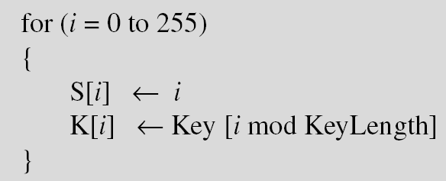
3. Stream Cipher and RC4
Initialization
Initialization is done in two steps:
Key Stream Generation
The keys in the key stream are generated, one by one.

Slide 20
Lecture 8: Stream Cipher and RC4
20
1…
2. RC4
RC4: simple case– RC4 3bits
RC4 3-bit is a variation of the RC4 algorithm.
It has a variable length key from 3 bits to 24 bits
The 24 bit state vector S[ ] has elements S[0], S[1], … S[8]
eg:
Plaintext: (7 2 5 1 5)oct {111 010 101 001 101}bin
Key: (7 4 3 2)oct {111 100 011 010} bin (keylen = 4*3bit=12)
2018/10/9
An Introduction to Information Security

Slide 21
Lecture 8: Stream Cipher and RC4
21
1…
2. RC4
RC4: simple case– RC4 3bits
The algorithm has three steps:
initialization,
initial permutation, and
stream generation.
2018/10/9
An Introduction to Information Security

Slide 22
Lecture 8: Stream Cipher and RC4
22
1…
2. RC4
RC4 3bits
initialization
initial permutation
stream generation
For initialization, use the following algorithm to initialize the state vector S and the vector T.
/* Initialization */
for i = 0 to 7 do
S[i] = i;
T[i] = K[ i mod keylen];
** NOTICE: this algorithm is the same as the RC4 except the loop is from 0 to 7 but not 0 to 255)
S[0] | S[1] | S[2] | S[3] | S[4] | S[5] | S[6] | S[7]
0 | 1 | 2 | 3 | 4 | 5 | 6 | 7
T[0] | T[1] | T[2] | T[3] | T[4] | T[5] | T[6] | T[7]
7 | 4 | 3 | 2 | 7 | 4 | 3 | 2
2018/10/9
An Introduction to Information Security

Slide 23
Lecture 8: Stream Cipher and RC4
23
1…
2. RC4
RC4 3bits
initialization
initial permutation
stream generation
use the following algorithm to produce the initial permutation:
/*Initial Permutation of S */
j = 0;
for i = 0 to 7 do
j = (j + S[i] + T[i]) mod 8;
Swap(S[i], S[j]);
Swap
S[0] | S[1] | S[2] | S[3] | S[4] | S[5] | S[6] | S[7]
0 | 1 | 2 | 3 | 4 | 5 | 6 | 7
T[0] | T[1] | T[2] | T[3] | T[4] | T[5] | T[6] | T[7]
7 | 4 | 3 | 2 | 7 | 4 | 3 | 2
i
j
Swap
Swap
0 | 0+0+7
7 | 1 | 2 | 3 | 4 | 5 | 6 | 0
Swap
1 | 7+1+4
7 | 4 | 2 | 3 | 1 | 5 | 6 | 0
2 | 4+2+3
7 | 2 | 4 | 3 | 1 | 5 | 6 | 0
3 | 1+3+2
7 | 2 | 4 | 6 | 1 | 5 | 3 | 0
Swap
7 | 3+5+2
7 | 2 | 5 | 1 | 3 | 0 | 6 | 4
2018/10/9
An Introduction to Information Security

Slide 24
Lecture 8: Stream Cipher and RC4
24
1…
2. RC4
RC4 3bits
initialization
initial permutation
stream generation
Next, since the plaintext contains 5 groups of 3 bits. 5 different values of k must be generated.
/* Stream Generation */
i, j = 0;
while (true)
i = (i + 1) mod 8;
j = (j + S[i]) mod 8;
Swap (S[i], S[j]);
t = (S[i] + S[j]) mod 8;
k = S[t];
Swap
S[0] | S[1] | S[2] | S[3] | S[4] | S[5] | S[6] | S[7]
7 | 2 | 5 | 1 | 3 | 0 | 6 | 4
t | k
-- | --
i
j
Swap
1 | 0+2
Swap
7 | 5 | 2 | 1 | 3 | 0 | 6 | 4
7 | 4
2 | 2+2
Swap
7 | 5 | 3 | 1 | 2 | 0 | 6 | 4
5 | 0
3 | 4+1
Swap
7 | 5 | 3 | 0 | 2 | 1 | 6 | 4
1 | 5
4 | 5+2
7 | 5 | 3 | 0 | 4 | 1 | 6 | 2
6 | 6
5 | 7+1
1 | 5 | 3 | 0 | 4 | 7 | 6 | 2
0 | 1
2018/10/9
An Introduction to Information Security

Slide 25
Lecture 8: Stream Cipher and RC4
25
1…
2. RC4
RC4 3bits: Encryption
The 5 values of k produced are (4 0 5 6 1). The RC4 3bit version generates random 3 bit patterns so these numbers represent 3 bit numbers. For example,
0 = 000 2 = 010 4 = 100 6 = 110
1 = 001 3 = 011 5 = 101 7 = 111
So {4 0 5 6 1}_{oct} = {100 000 101 110 001}_{bin}
This can be XOR with the plaintext to produce the ciphertext.
Plaintext: (7 2 5 1 5) ={111 010 101 001 101}bin
⊕ Key: (4 0 5 6 1) ={100 000 101 110 001}bin
=Cipher: (3 2 0 7 4) ={011 010 000 111 100}bin
2018/10/9
An Introduction to Information Security

Slide 26
Lecture 8: Stream Cipher and RC4
26
1…
2. RC4
RC4: Security
claimed secure against known attacks
have some analyses, none practical
result is very non-linear
since RC4 is a stream cipher, must never reuse a key
have a concern with WEP, but due to key handling rather than RC4 itself
2018/10/9
An Introduction to Information Security

Slide 27
Lecture 3: Overview of Cryptography (II)
Summary
Stream Cipher
Random key stream, xor plaintext/ciphertext
RC4: byte oriented stream cipher
initialization
initial permutation, and
stream generation
encryption/decryption: xor

Slide 28
An Introduction to Information Security
Thanks for your attention!
Q&A

